Slide 1
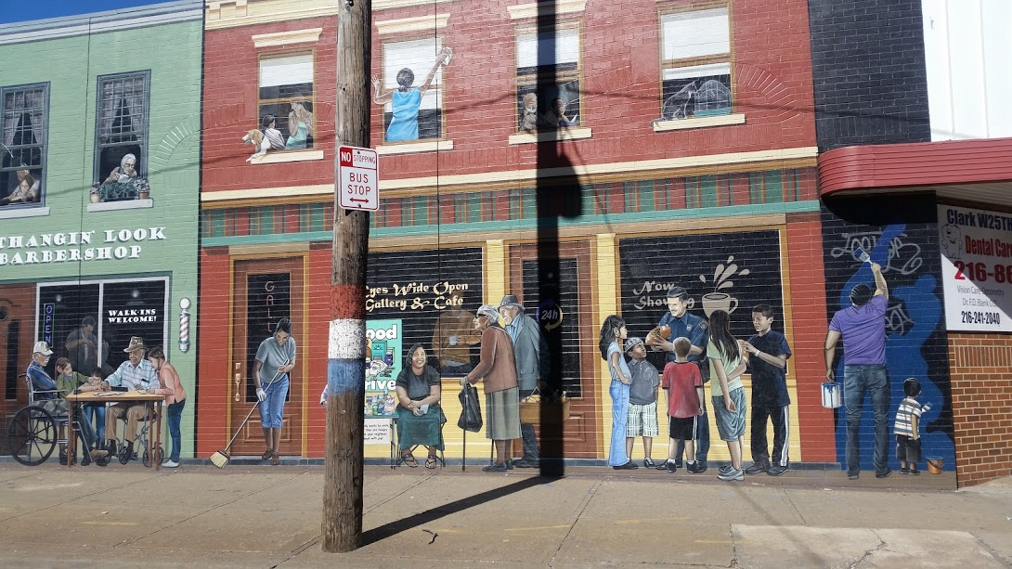
What is place attachment?
Movers, Rooted, and Stuck
Soul of the Community (SOTC) – research scope + research findings
Specific behaviors that promote place attachment
Examples of efforts promote place attachment in Buckeye, Mt Pleasant and Woodland Hills

Slide 2
Place attachment :
the emotional bond between person and place, and is a main concept in environmental psychology. It is highly influenced by an individual and his or her personal experiences.
Rooted – love where you live – the place fits you
Stuck – lack of resources or will to leave a place that doesn’t fit you
Mobile – quick to move – always searching
Place attachment survey instrument

Slide 3

Knight Foundation + Gallup Org
26 Cities
3 years
15,000 people were surveyed

Slide 4
Research findings:
Surprisingly it was NOT basic services, schools or public safety or jobs
The drivers of attachment are:
Openness – how welcoming the community is to different people
Aesthetics – physical beauty and green spaces
Social offerings – opportunities for social interaction and citizen caring

Slide 5
What are some behaviors that promote and support attachment to place?
Find and do things that the neighborhood is known for
Shop local
Walk and/or bike the neighborhood
Say hi to your neighbors + get active in local political efforts/block clubs

Slide 6
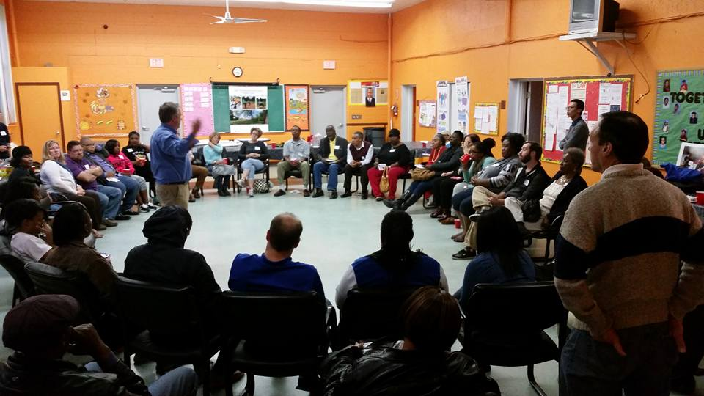

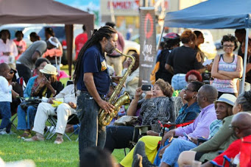
Openness
Aesthetics
Social offerings

Slide 7
Additional resources:
The Art and Science of Loving Where You Live – Melody Warnick
Follow the work of: Cleveland Neighborhood Progress, Neighborhood Connections, LAND Studio, ioby, Saint Luke’s Foundation, KSU CUDC, WRLC
Rate your level of attachment using Place attachment survey instrument

Slide 8
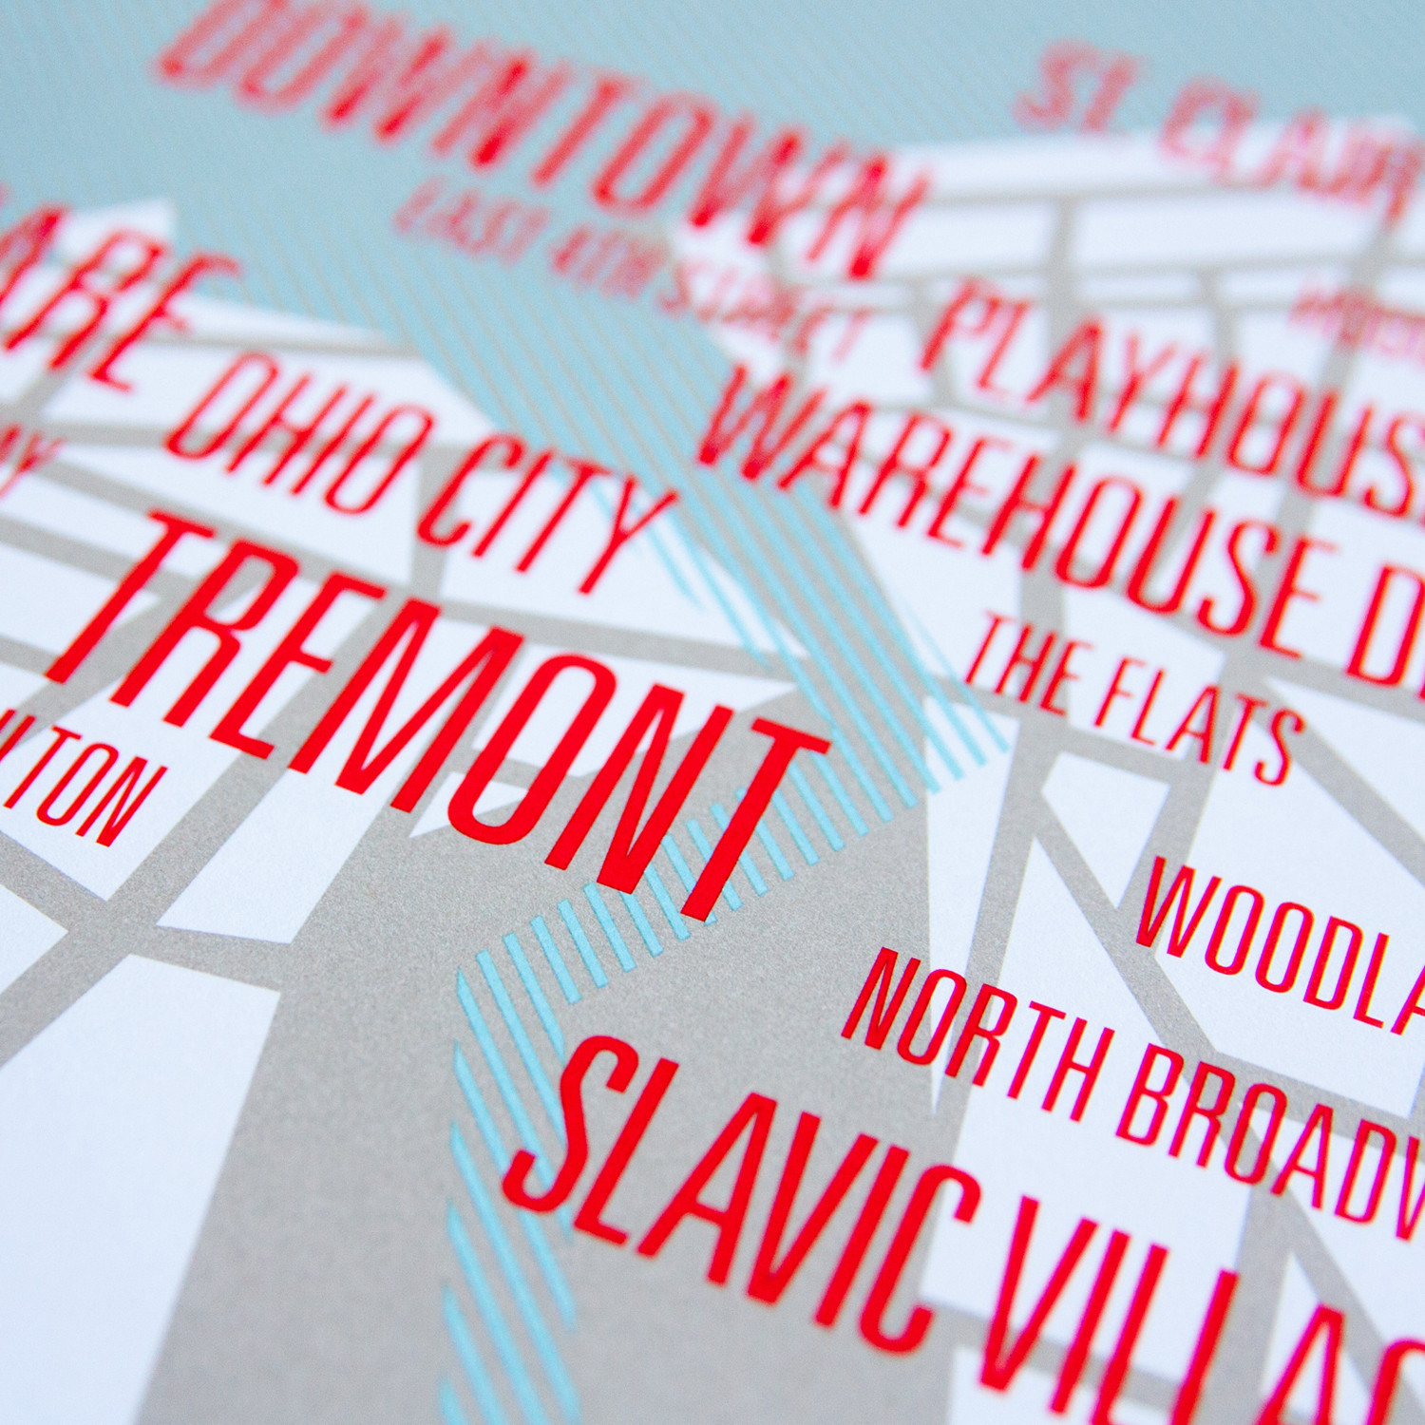
Where we choose to live is the single most important decision we make” Richard Florida, author of Who’s Your City? and Rise of the Creative Class

